Slide 1
Current Trends in Athletic Training
Heather Harvey, MA, ATC
Mike Fernandez, ATC, PTA, ITAT
Chase Paulson, MS, ATC
Notes:
Chase: Open the presentation to the audience & present the speakers

Slide 2
Introduction
Athletic Training Today
What an Athletic Trainer Can Do for You
Emergencies in Athletics
Implementing Health and Safety Laws in Athletics
Notes:
Chase: Briefly describe the topics and who will be speaking on them

Slide 3
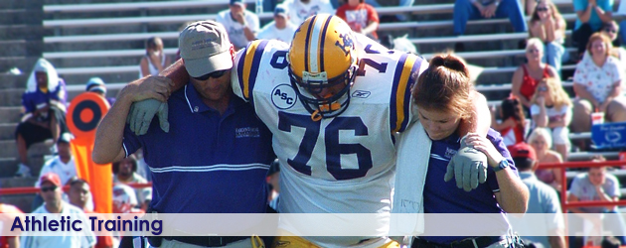
Athletic Training Today
Certified Athletic Trainer
Education
Clinical Skills
www.bocatc.org
www.nata.org
Nationally vs. in California
Regulation
Advocacy
www.ca-at.org
www.Atyourownrisk.org
Notes:
Heather:

Slide 4
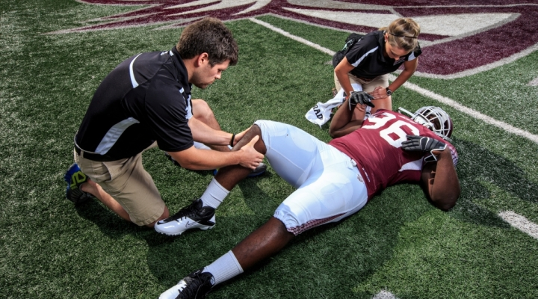
Athletic Training Today
Old Ways
New Ways
Jack of All Trades
First to arrive, last to leave
Coach/Team Member
Ankle Taper
Student Athletic Trainers
Primary Care Provider
Valuable healthcare resource
Advocate for the patient
Expert in prevention, treatment, and rehabilitation of injuries
Notes:
Heather

Slide 5
Athletic Training Today
25 California student athletes have died since 2010*
8 Football
4 Basketball
3 PE
3 Soccer
2 Cheerleading
2 Swim/Water
2 Other
*Data taken from media sources and compiled by the California Athletic Trainers’ Association

Slide 6
Athletic Training Today
Benefits of Participating in High School Sports*
High School students who play sports are less likely to drop out
Former student athletes tend to earn significantly higher incomes than those who did not play sports
Physically active children are 15% more likely to attend college
*http://www.atyourownrisk.org/wp-content/uploads/2016/05/infographics.pdf

Slide 7
Athletic Training Today
Risks of Participating in High School Sports*
Secondary school athletic population leads the nation in sports-related deaths
15 to 17 year olds experience the highest rate of sports-related emergency room visits
Concussion rates have increased
90% of athletes have been injured playing a sport
*http://www.atyourownrisk.org/wp-content/uploads/2016/05/infographics.pdf

Slide 8
Athletic Training Today
“At this critical time, there needs to be an increased commitment by our member schools to provide the essential services that our student-athletes need when it comes to the prevention and care of athletic injuries.”
-Rob Wigod

Slide 9
Athletic Training Today
http://www.nata.org/sites/default/files/funding_appropriate_medical_care_in_the_secondary_school.pdf

Slide 10
Athletic Training Today
http://www.nata.org/sites/default/files/secondary-school-position-improvement-guide.pdf
http://www.nata.org/sites/default/files/secondary-school-position-proposal-guide.pdf

Slide 11
What an AT Can Do For You
Increase the value of the Athletic Department
Risk mitigation
Decrease insurance premiums
Increase overall safety of student athletes
https://www.youtube.com/watch?v=G4e5ZNjvBgU
Notes:
Chase

Slide 12
What an AT Can Do For You
Plan for Emergencies in Athletics
Emergency Action Plans (EAPs)
What is it?
Why is it necessary?
How does it help me?
Components of the Plan
Personnel
Chain of Command
Duties
Emergency Equipment
Notes:
Chase:
Establish venue-specific Emergency Action Plans (EAP)
What is it?
A detailed set of guidelines for handling any emergency situation
Why is it necessary?
Everyone knows their role
Improved communication
Step-by-step procedures
How does it help me?
Decreases the chance of human error
Minimizes litigation - 6P’s (Prior Planning Prevents Piss Poor Performance)
Increases patient outcomes from unplanned crises or emergency situations
Personnel & numbers of importance
Admin, EMS, district personnel
Chain of command & delegation of duties
In the absence of any individual, what changes?
Equipment available for use
Where is it located, who has access?

Slide 13
Emergencies in Athletics
Emergency Action Plans, cont.
Communication
Planning
Transportation and access
Documentation
Review
Notes:
Chase:
Communication & planning
Pre-season meetings, dispersal of information
Transportation & access
EMS vs. parent transport
Gates, locks, keys, construction
Documentation & review
Incident reports, debriefing, room for improvement?

Slide 14
Emergencies in Athletics
Scenario-Based Situations Not Normally Planned For
Extreme and/or catastrophic injuries
Weather-related emergencies
Lock-down or Active Shooter
Absence of a medical professional
Notes:
Chase: Maybe include how to manage a cheerleader that falls from a stunt during a pep rally? What if the site does have an AT but they took the day off?
Extreme injuries
Seizures, stroke, concussion, etc.
Weather-related emergencies
Heat illness, lightening, air quality, etc.
Lockdown & shelter-in-place
Active shooter, earthquake, fire, etc.
Absence of medical professional
No certified athletic trainer or EMT on site

Slide 15
Emergencies in Athletics

Slide 16
Emergencies in Athletics
https://www.nata.org/sites/default/files/timeout.pdf

Slide 17
Emergencies in Athletics

Slide 18
Emergencies in Athletics

Slide 19
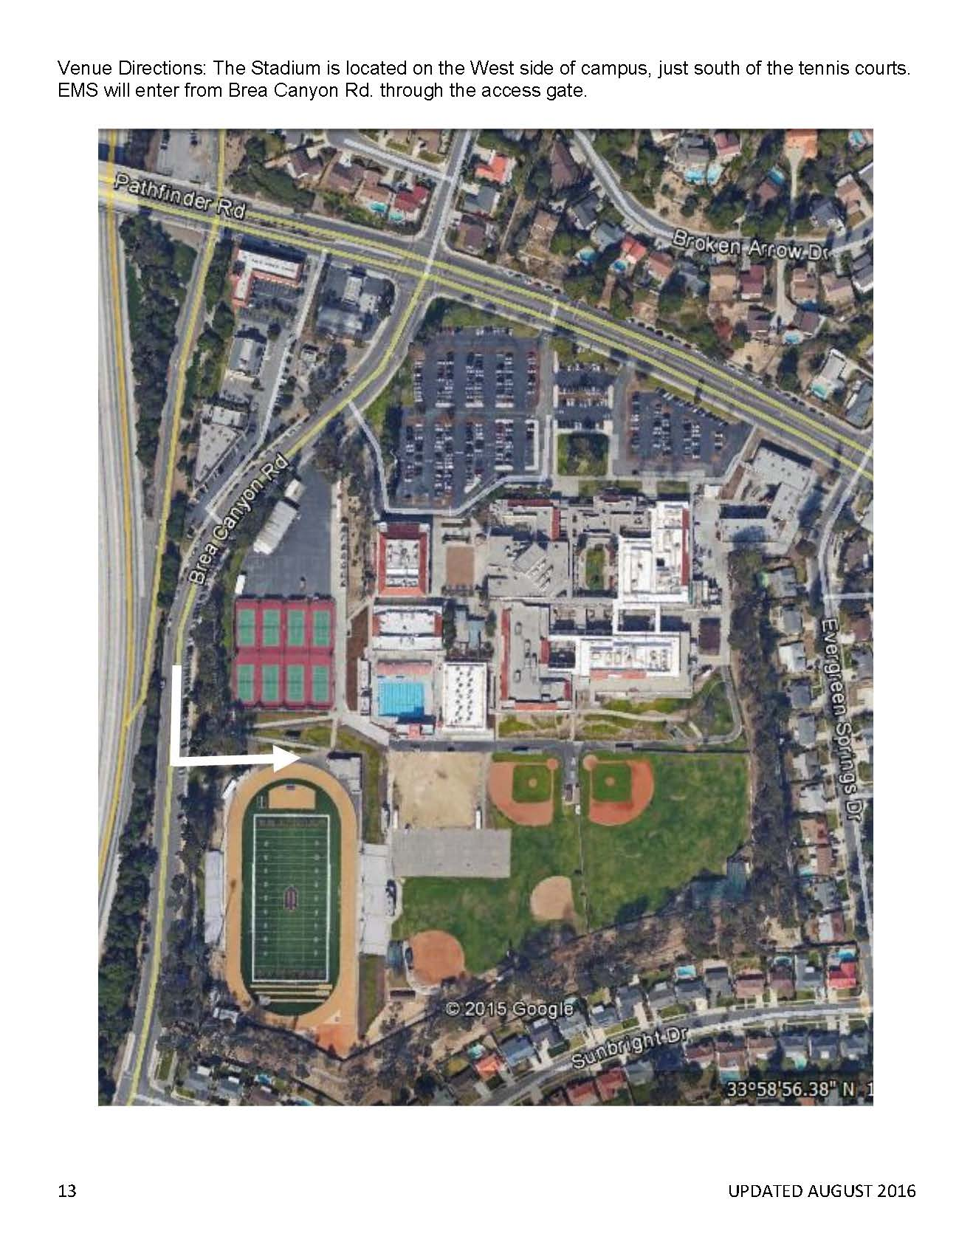
Emergencies in Athletics

Slide 20
Implementing Health and Safety Laws in Athletics
Current Rules Governing Youth Safety and Safety Education
California Education Code 49475 (AB 2127)
2 full contact practices/week, 90 min/practice
No full contact out of season and team camps = practice
Athletes suspected of having concussion removed from contest/rest of activity
May resume activity only after clearance by “licensed health care provider trained in management of concussions”
Athlete must complete graduated RTP before full release
Concussion education sheet signed and returned by athlete and parent/guardian
AB 1639 - Sudden Cardiac Arrest (SCA)
SCA education sheet signed and returned by athlete and parent/guardian
Students suspected of symptoms of SCA or passes out/faints after activity may be removed from activity
Student may not return until cleared by physician, NP, PA in accordance with standardized practice procedures
Notes:
Mike

Slide 21
Implementing Health and Safety Laws in Athletics
AB 2007 Youth Athletics and Concussions
Mandates many of the same provisions as AB 2127 youth sports
HR 921/689: Sports Medicine Licensure Clarity Act
Allows for Athletic Trainers travelling with teams across state lines to be able to provide care to the athletes on their teams.

Slide 22
Implementing Health and Safety Laws in Athletics
HR 112/ S 83: Secondary School Student Athletes’ Bill of Rights
Whereas the Secondary School Student Athletes’ Bill of Rights sets forth that secondary school student athletes have the right to:
Be coached by individuals who are well-trained in sport-specific safety and to be monitored by athletic health care team members;
Quality, regular pre-participation examinations and each athlete has the right to participate under a comprehensive concussion management plan;
Participate in sporting activities on safe, clean playing surfaces, in both indoor and outdoor facilities;
Notes:
Mike

Slide 23
Implementing Health and Safety Laws in Athletics
HR 112/ S 83: Secondary School Student Athletes’ Bill of Rights
Whereas the Secondary School Student Athletes’ Bill of Rights sets forth that secondary school student athletes have the right to:
Utilize equipment and uniforms that are safe, fitted appropriately, and routinely maintained, and to appropriate personnel trained in proper removal of equipment in case of injury;
Participate safely in all environmental conditions where play follows approved guidelines and medical policies and procedures, with a hydration plan in place;
A safe playing environment with venue-specific emergency action plans that are coordinated by the athletic health care team and regularly rehearsed with local emergency personnel;
Privacy of health information and proper referral for medical, psychosocial, and nutritional counseling;

Slide 24
Implementing Health and Safety Laws in Athletics
HR 112/ S 83: Secondary School Student Athletes’ Bill of Rights
Whereas the Secondary School Student Athletes’ Bill of Rights sets forth that secondary school student athletes have the right to:
Participate in a culture that finds “playing through pain” unacceptable unless there has been a medical assessment;
Immediate, on-site injury assessments with decisions made by qualified sports medicine professionals
Along with their parents, the latest information about the benefits and potential risks of participation in competitive sports, including access to statistics on fatalities and catastrophic injuries to youth athletes; and
Whereas the Secondary School Student Athletes’ Bill of Rights, which sets forth goals and ideals to improve the health, well-being, and athletic experience of secondary school students, can serve as a valuable resource to reduce injury, promote athlete safety, and encourage well-being

Slide 25
Implementing Health and Safety Laws in Athletics
Concussions 101 - A Review for Athletics
Notes:
Mike

Slide 26
Implementing Health and Safety Laws in Athletics
Importance of School Administration’s Knowledge of Concussions
The Principal has been identified as a main key player in assisting students with concussion injuries
What is the schools response plan to assist students with concussion injuries?
Who is the point person to be the advocate for the injured athlete at your school?
Who makes up your intervention team?
“Return to Learn” vs. “Return to Play”
Each case will be different
RTL starts from day 1 post injury – Can the student tolerate a full day of school?
What are physician recommended adjustments?
Can the student continue/tolerate adjusted association w/ team activities
What will be the plan for management of students school day, week, month
Once student able to tolerate a full school day, they may proceed to RTP
RTP is hopefully going to be much shorter in duration as long as RTL is managed correctly

Slide 27
Questions?

