Slide 1
League Sportsmanship Symposiums
John Tibbels- Ramona High School
Nicki Kosik- San Dimas High School

Slide 2
Why: Why do we do this?
Who: Who gets invited?
What: What happens during the event?
Where: Where can you host it?
When: When is the best time to have this event?

Slide 3
Why?
Sportsmanship is a Priority in our league
Proactive not Reactive
Educate the leaders of our sports teams

Slide 4
Why?
Build League Camaraderie
Show our athletes that we are all “the same” person on each of our campuses
Build leaders in hopes they can teach others on their campus

Slide 5
Sportsmanship Award:

Slide 6
Who?
12-15 Underclassmen from each school
Ask for coaches to send students who are leaders on their teams
Students are asked to bring back the sportsmanship themes to their teams

Slide 7
Ramona Students Attending the RVL Sportsmanship Symposium
Brandon Osayande, 11th- Football- Large
Prentice Burris, 11th- Girls Basketball, Track- Large
Cori Zuvia, 9th- Cross Country- Small
Aaliyah Rebolledo, 10th- Softball- Medium
Celine Alvarez, 10th- Softball- Medium
Anthony Mendoza, 11th-Anaya- Boys Basketball, Large
Michelle Gutierrez, 11th- Girls Water Polo- Medium
Jeffry Kobus, 10th- Boys Water Polo- Small
John Gidcomb, 10th- Boys Golf/Water Polo- Large
Vincent Carbajal, 10th- Football- Large
Kareena Dewberry, 11th- Girls Tennis- Small
Julian Boyer ,11th- Football- extra large
Oluwatobi Muriuki, 11th- Volleyball
Jessican Inzunza, 11th- Cross Country- small
Bianca Cisneros, 9th- Girls Golf- small
Lauren Prendergrast, 9th- Girls Golf- Large

Slide 8
Who?
10 leaders from each school in the league
5 boys/5 girls
We try to choose athletic leaders that are also part of ASB

Slide 9
Group Template
Invitation Letter

Slide 10
What?
Relevant Speakers
Discussion in small groups- What is Sportsmanship?
Sportsmanship Videos
Scenarios- Role Play
De-Brief and Lunch

Slide 12
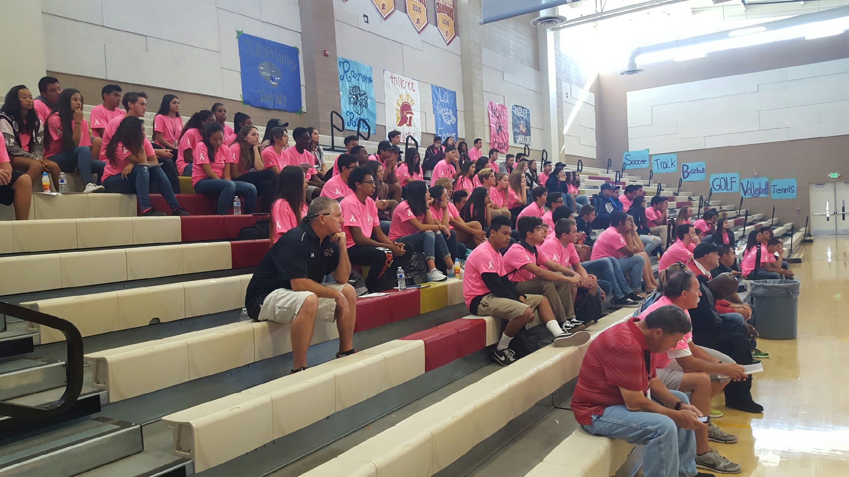
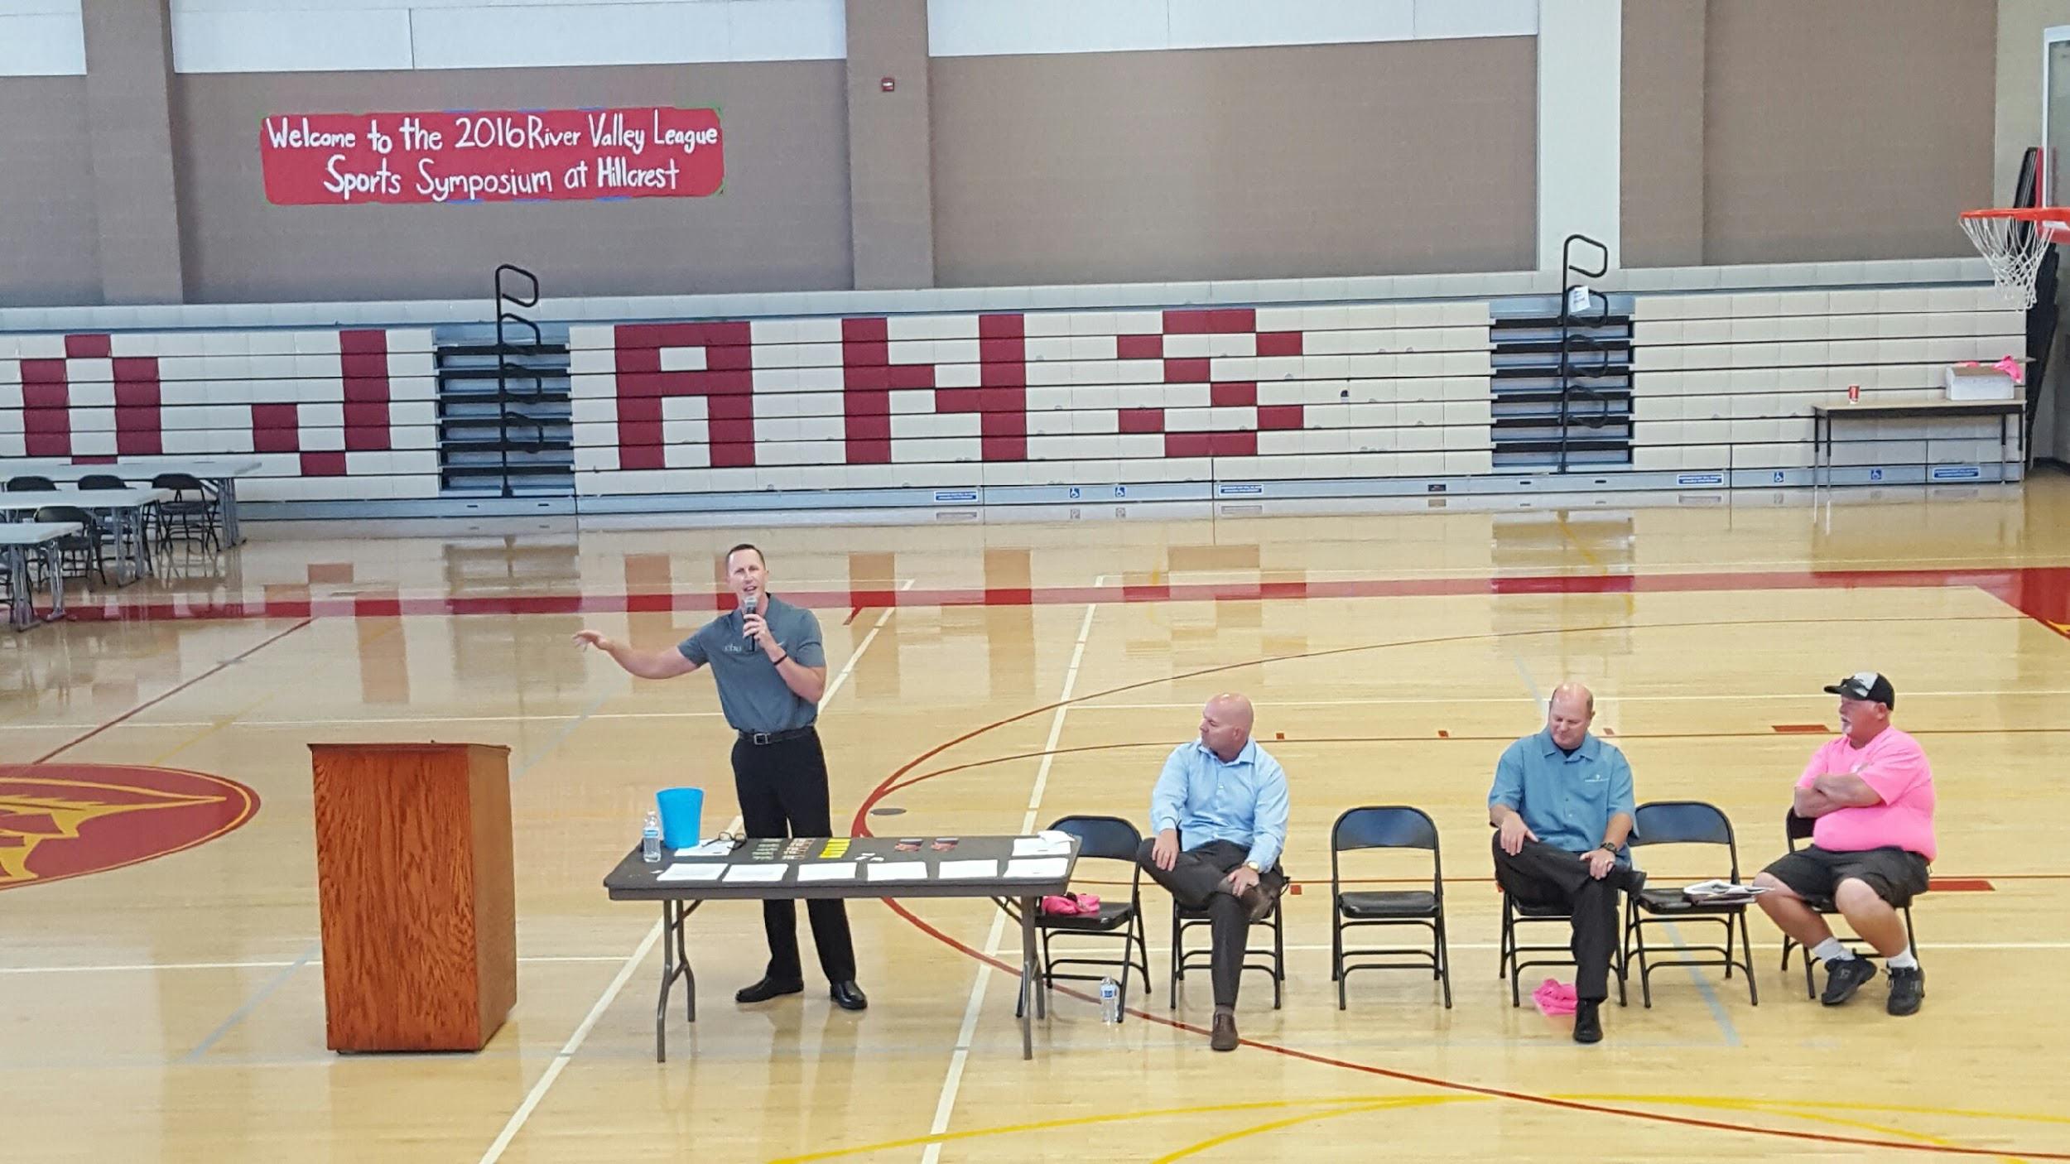
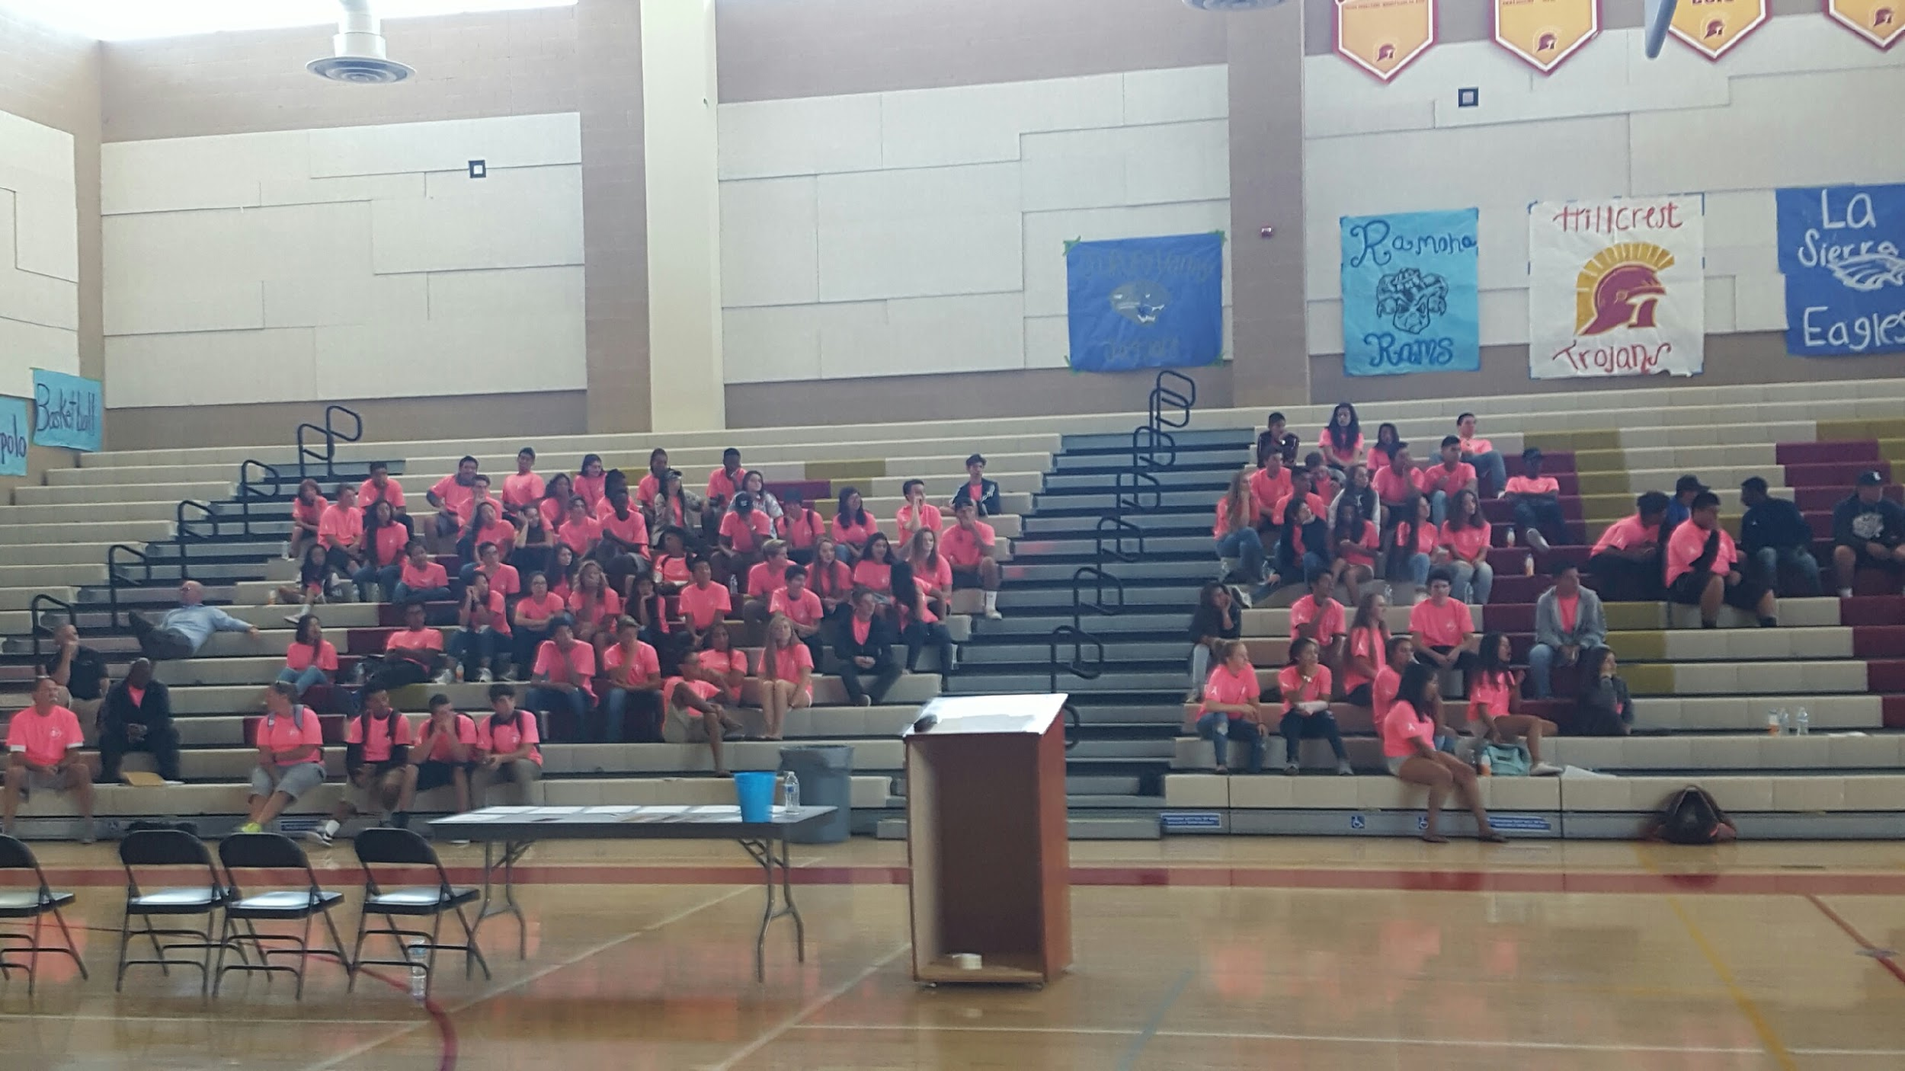

Slide 14
Symposium Questions for small groups
1. What does Sportsmanship mean to you? What does it look like in the locker room? At Practice? In the Game? After the Game?
2. What unsportsmanlike behaviors have you seen as athletes from teammates/opponents?
3. What unsportsmanlike behaviors have you seen as athletes from adult fans?
4. What unsportsmanlike behaviors have you seen as athletes from your coach? From the opponent's coach? From officials?
5. How does your behavior on the field of play contribute to teammates/opponents behavior?
6. How can you as athletes help shape the behavior of the team and opponent before the game, during the game and after the game?

Slide 15
CASE STUDY - Basketball
Narrator: Two basketball teams are playing a great game. The score goes back and forth and back and forth.
Act Out:
Narrator: The Score is tied at the end of regulation 52 to 52 with the visiting team just missing a layup with 1 second to go in which the visiting Team’s coach thought his player was fouled. No foul was called on the play. Tie game
Act Out:
Narrator: The Visiting team coach, after 0:00 on the clock, asks the official for a conference and proceeds to rip him with profanity. He says he can’t believe there was no foul called:
Act out:
Narrator: If you are the official, What do you do? Do you let the coach have some slack because it is a close game? Do you give him a technical foul for using profanity?
Act out: What do you do? What is the sportsmanship thing to do?
Discussion:

Slide 16
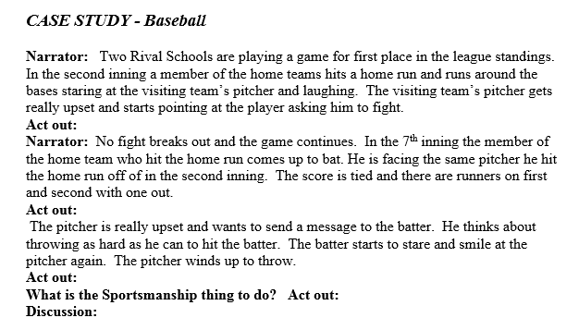

Slide 17
Groups present their Case studies to the group
Athletic Directors vote for the best presentations. (Winning team receives gift cards)
Debrief with home school/ Lunch

Slide 18
What?
Guest Speakers
Ice-Breaker Activities
Relay Race Competition
Team Building
More and Less
League Motto/Mission Statement/Banner
FOOD!

Slide 19
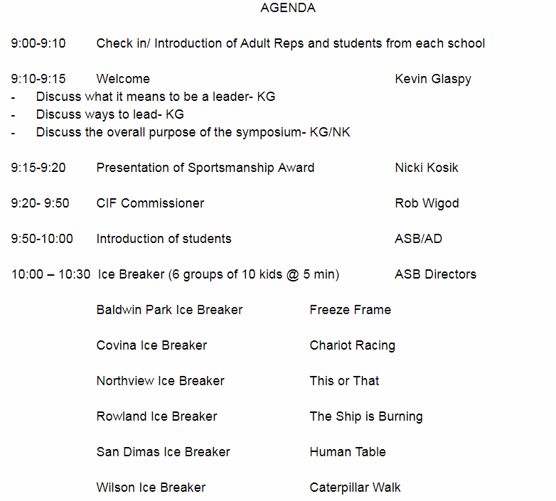
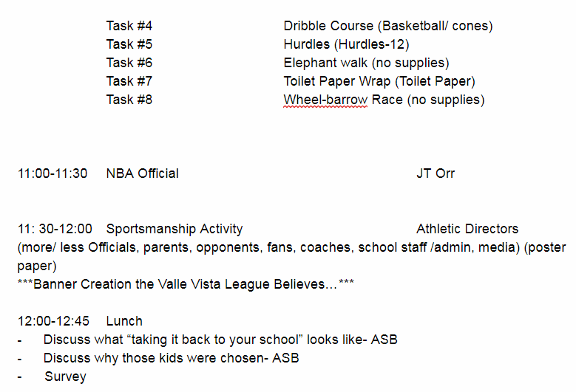

Slide 20
Agenda
More and Less

Slide 21
Where?
Rotated to all 6 schools in our league
Gymnasiums, Auditoriums, Theatres
Classrooms

Slide 22
Where?
Gym/ Venue with enough space to accommodate approximately 90 people who are doing activities
At the League Coordinator’s school originally, but adults wanted AC (which is always nice)

Slide 23
When?
Some time in October
We try to avoid homecoming week, playoffs if possible
Morning- get kids back to class and practice or games

Slide 24
When?
Early in the school year so that athletes can utilize what they learn all year
Typically last week in September to avoid Homecoming weeks and try to get Rob there
Morning time so the athletes can get back for practice and/or games

Slide 26
VVL Mission Statement
The mission of the Valle Vista League is to promote a positive atmosphere, good sportsmanship, and respect toward all teams so that win or lose, we stand as one.

Slide 27
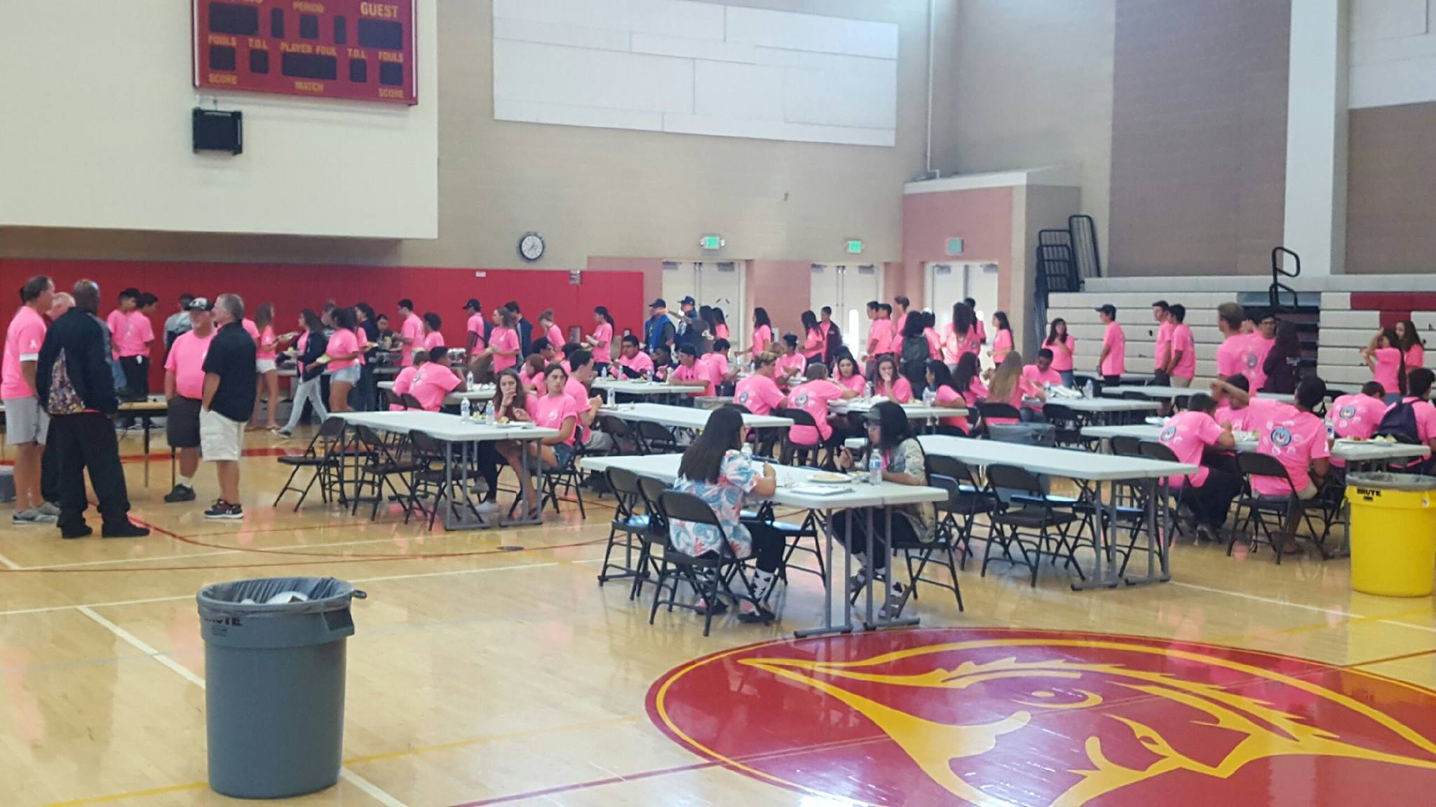
Picture Proof

Slide 28
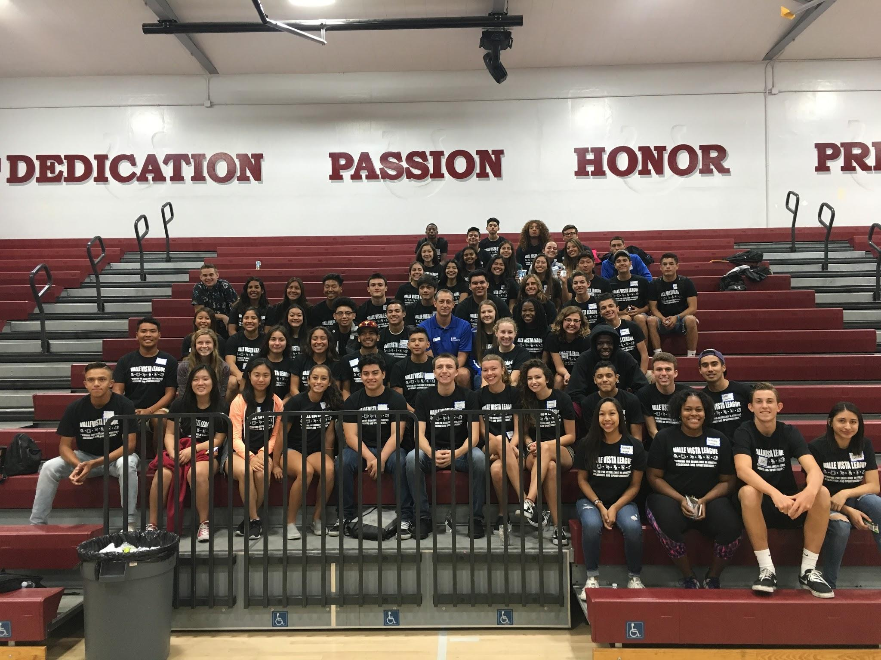
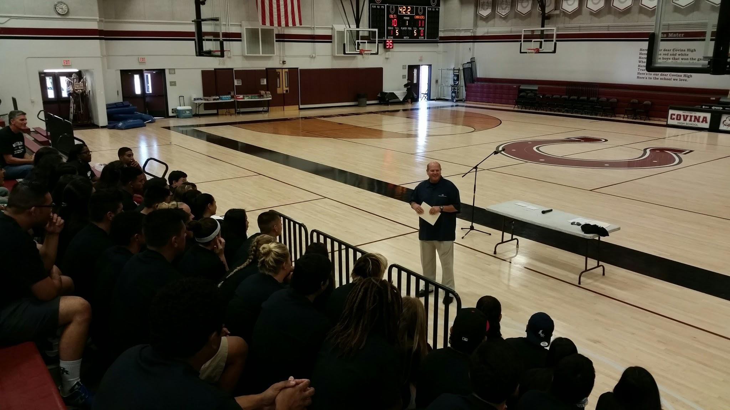
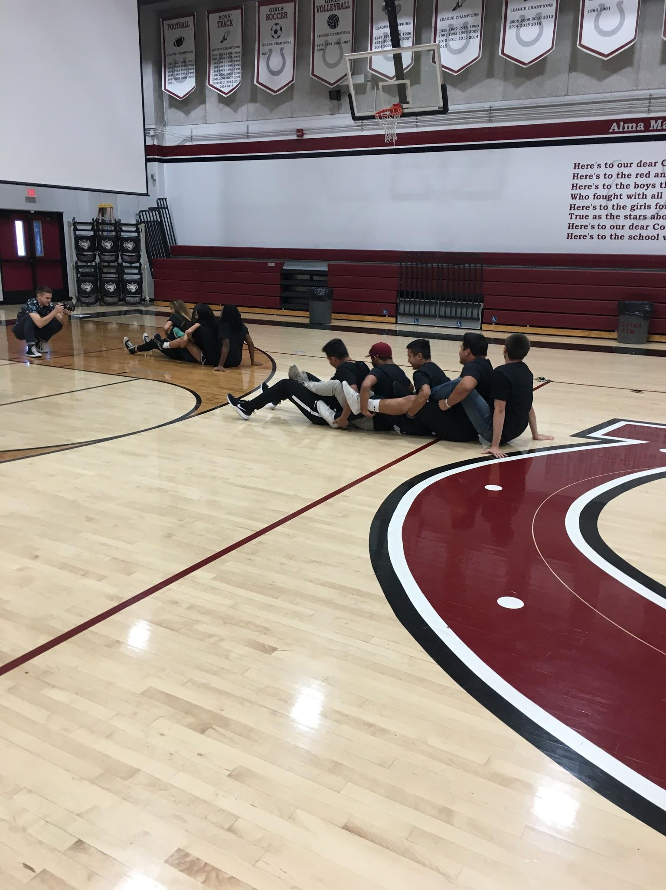
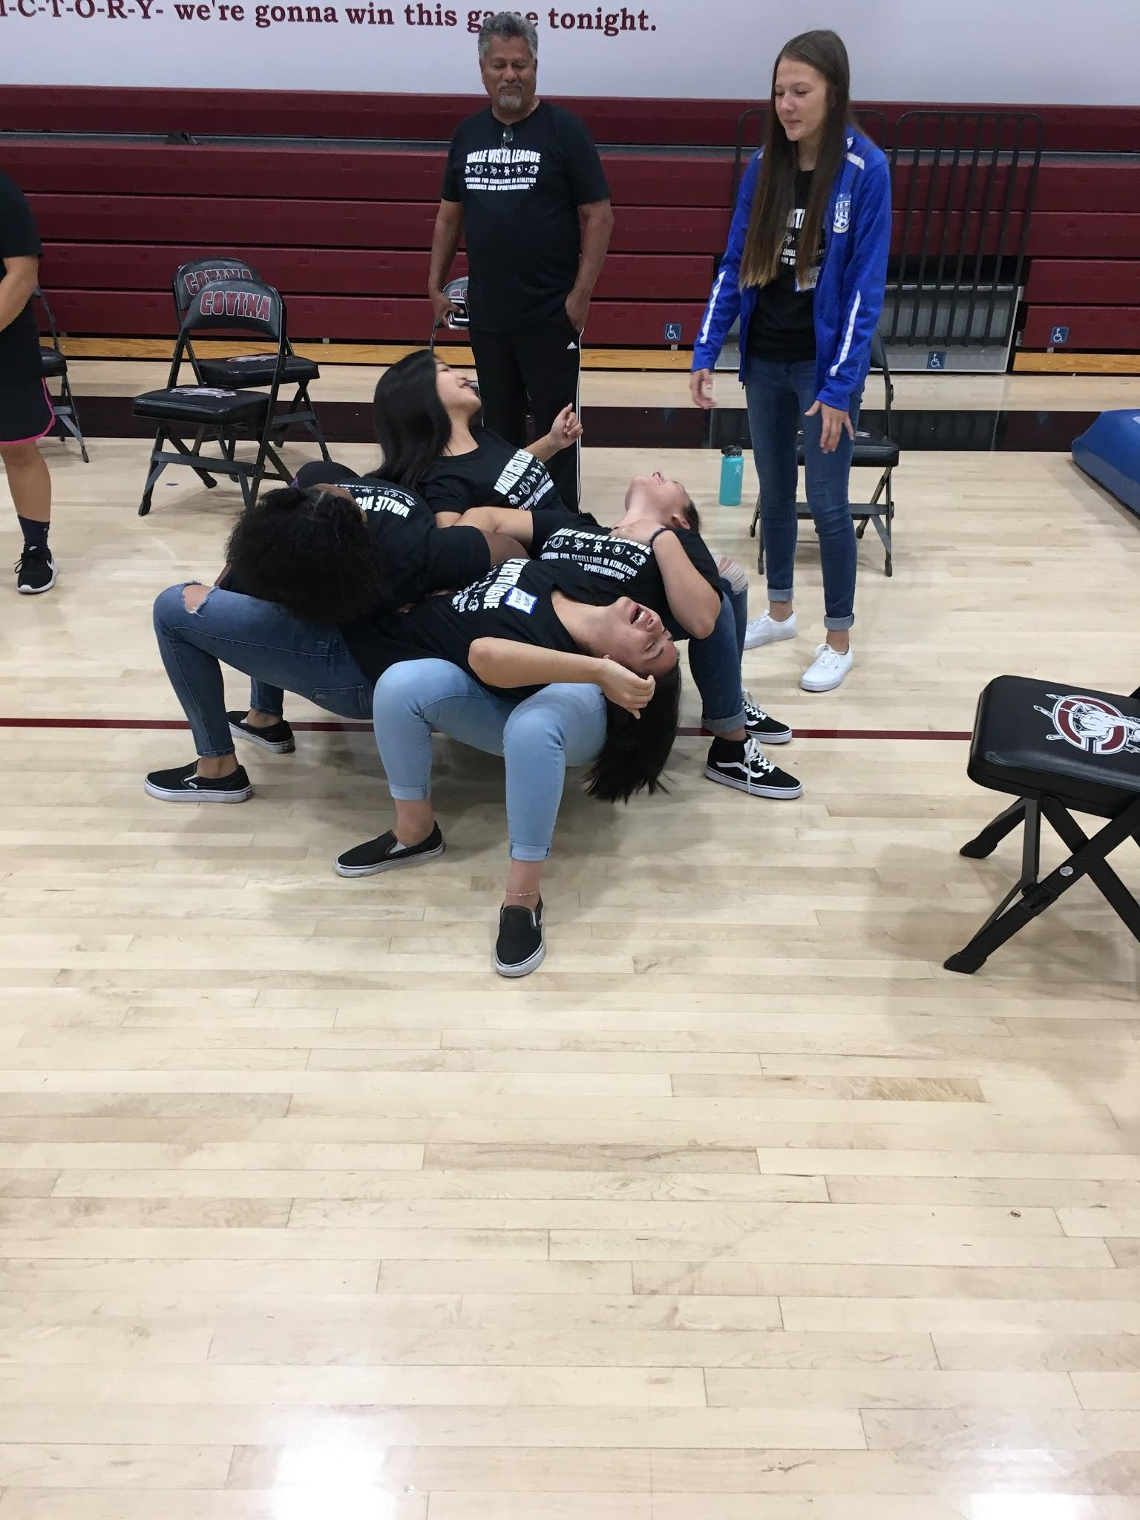
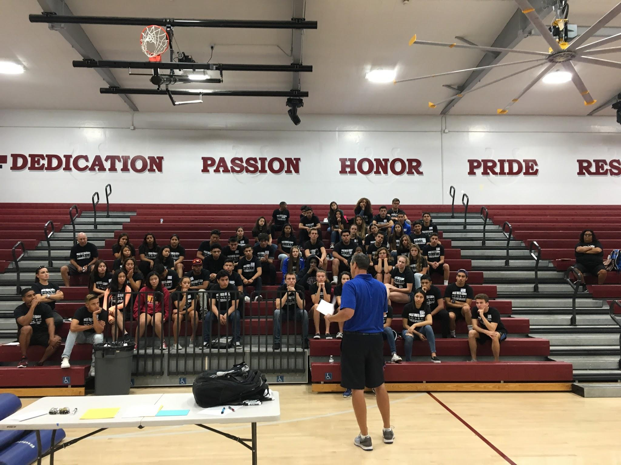
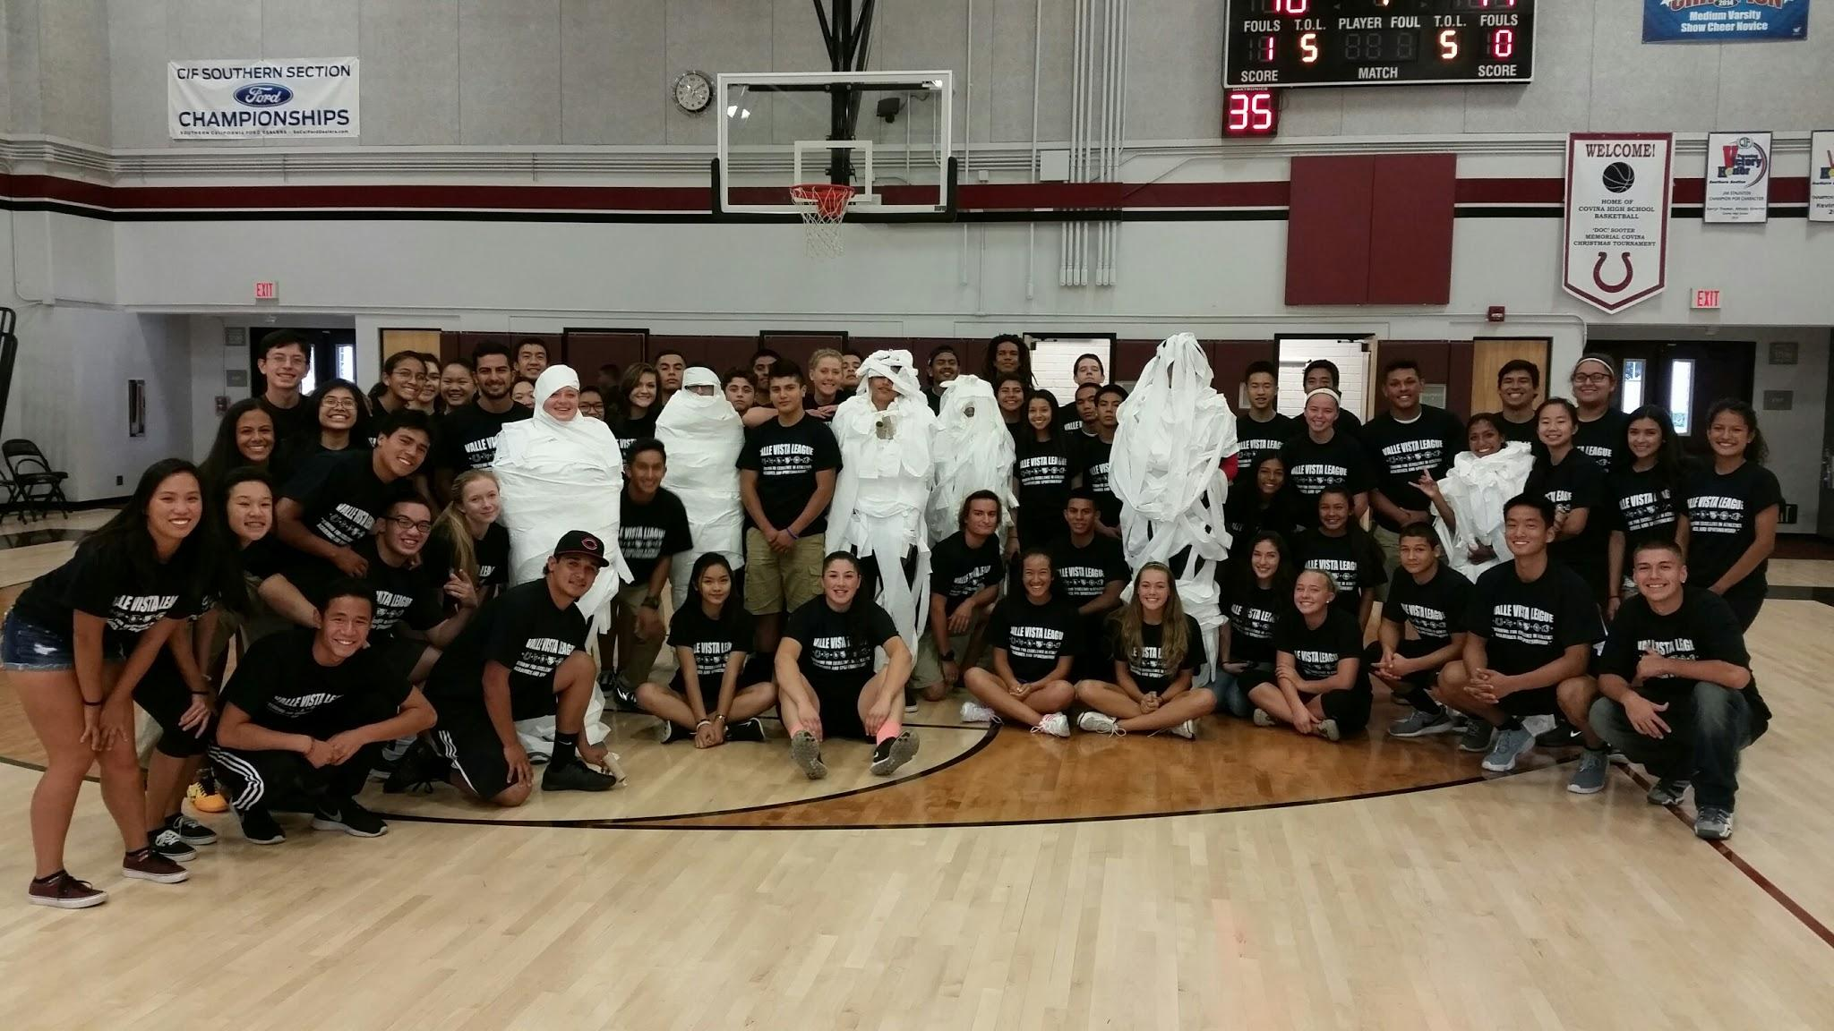
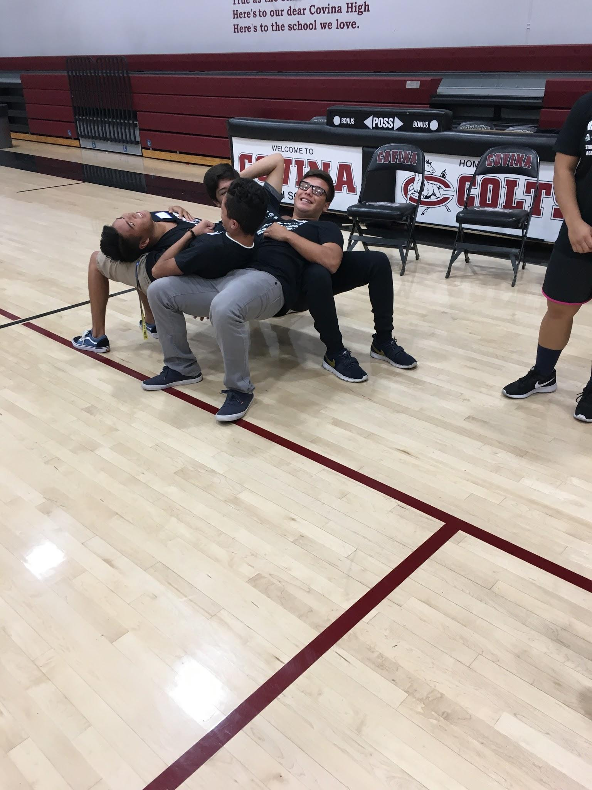
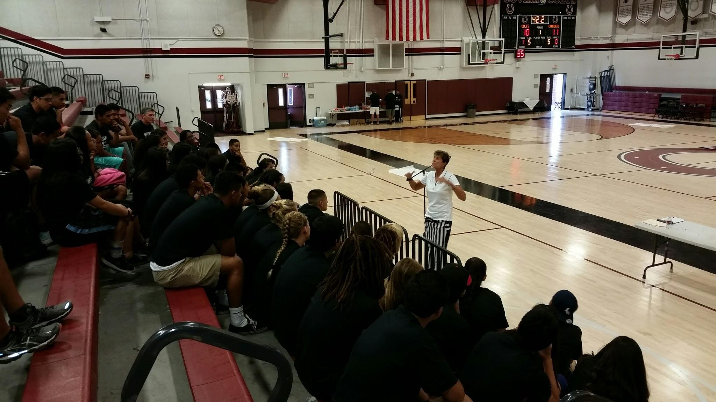
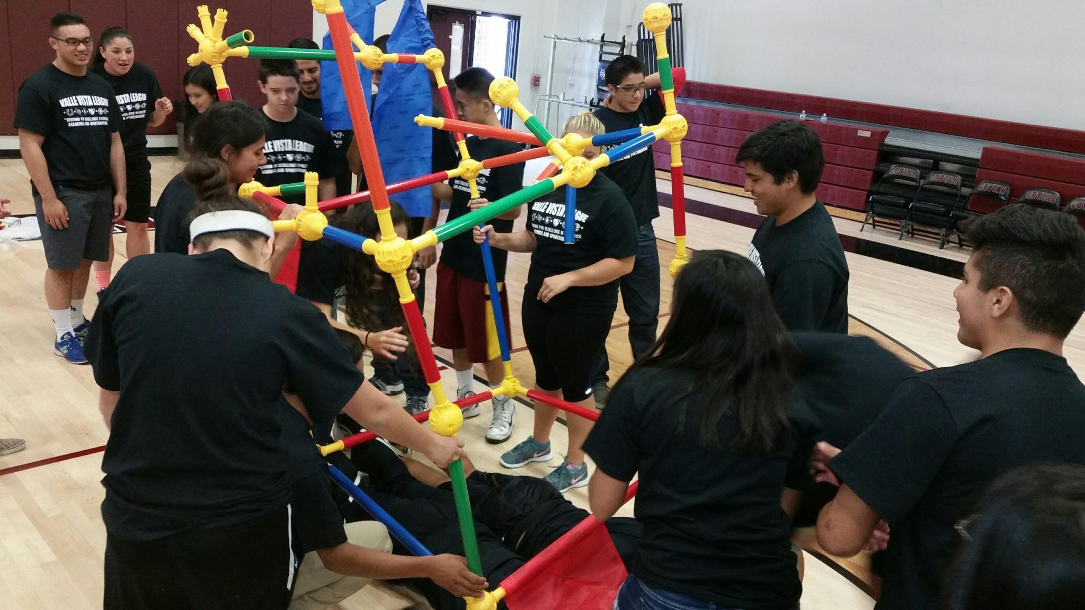

Slide 29
Links
https://www.youtube.com/watch?v=jocw-oD2pgo The Homerun- Western Oregon Softball Story

Slide 30
Links
https://youtu.be/RfTtHV_73Kg
Sportsmanship clips in various sports

Slide 31
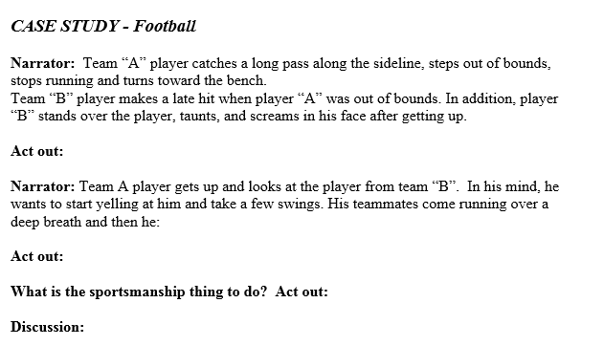

Slide 32
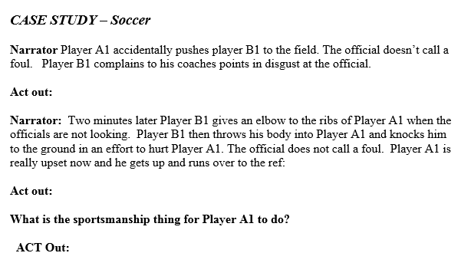

Slide 33
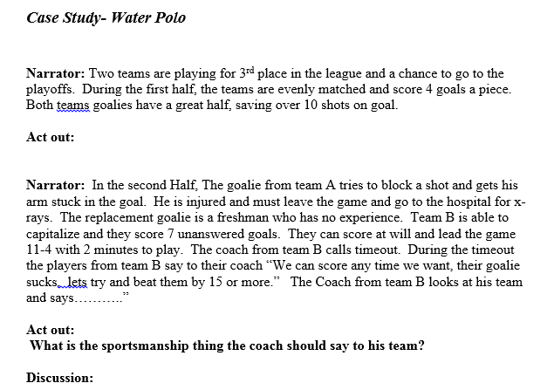

Slide 34
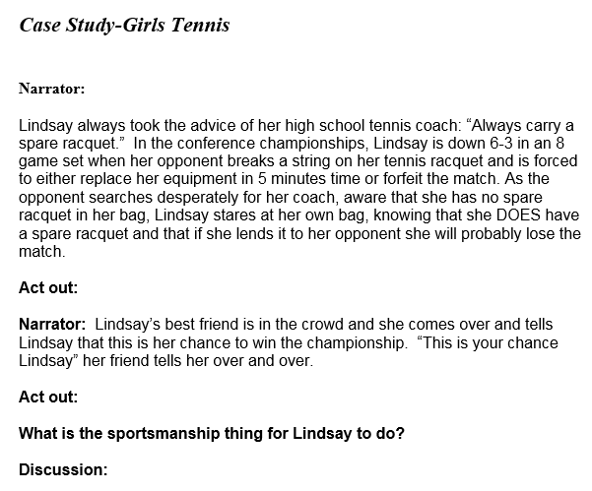

Slide 35
Contact Us!!
John Tibbels: jtibbels@rusd.k12.ca.us
Nicki Kosik: n.kosik@bonita.k12.ca.us
https://docs.google.com/presentation/d/1X_OZJ0iTA1DRejcKYSeNa2Z-E6r3GOCnhVaKLRux0bs

